Slide 1
Logo animation (intro)

Slide 2

Title slide
Outlook Addin development
Customized empowerment
Lucas Jellema
Conclusion Code Café – June 2024

Slide 3
Outlook Addin development
Why? use cases
What can be done? Types of interaction
buttons, automated actions, notifications, taskpane, mini app that runs in Outlook context
read selected emails, currently selected content & invitations and process information
inject content into edited items (emails, invitation)
respond to events
How?
generate Office Addin (as vanilla HTML or React, for Outlook, Powerpoint, Word, Excel, OneNote)
edit manifest.xml
add resources: taskpane HTML, CSS & JS, icons (additional libraries, turn into Vue application)
Examples
Collect details from emails and responses to invitations (and feed into CRM or other tools)
Rich mail reading experience – context pane with LinkedIn profile, list of recent mails from sender, …
Smart, enriched composition of emails, management of custom mailing list
Open Map for selected address, LinkedIn page for selected name, Product Page for SKU
Notes:
https://developer.chrome.com/docs/extensions/develop

Slide 4
Objectives
More productivity, higher quality, more fun acting on
Composition of Emails and Invitations
Reading & Processing of Emails and Event Responses

Slide 5
How
Addins can be event triggered or user activated
Build using client side web technology: HTML, CSS, JavaScript & Icons/Images
Outlook is a web application (both web and desktop)
Addins run in an IFRAME
And have access to Office API (office.js)
Addins can be
loaded from local or central web server
consumed from Microsoft AppSource (publicly) or Microsoft 365 admin center (within organization)
Note: Addins can also (and similarly) developed for PowerPoint, Word, Excel and OneNote
Teams Apps are different

Slide 6
Hello World Add in
Goto GitHub Repo: github.com/OfficeDev/Office-Add-in-samples/tree/main/Samples/hello-world/outlook-hello-world
Download Manifest File
Access https://aka.ms/olksideload
Manage Addins, Add Addin, Upload Manifest File
Create New Email, Open Addin from Apps icon
Notes:
https://github.com/OfficeDev/Office-Add-in-samples/tree/main/Samples/hello-world/outlook-hello-world

Slide 7
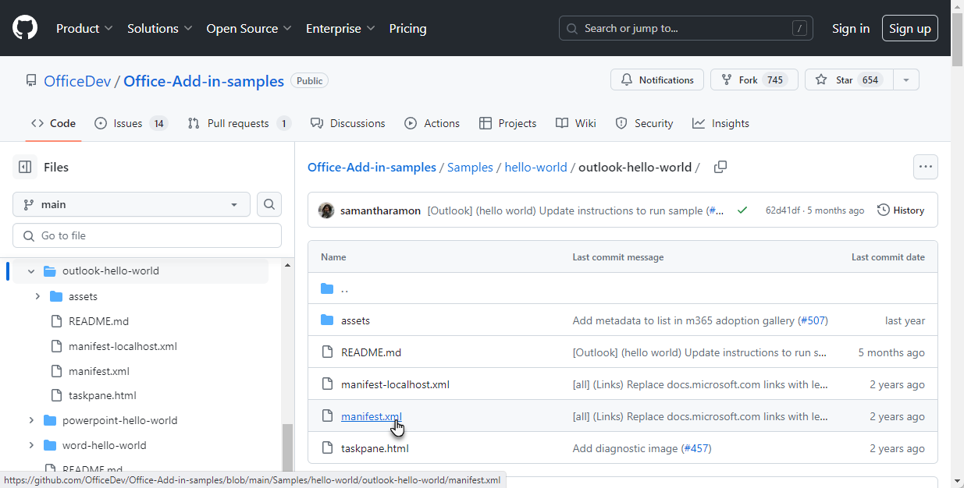
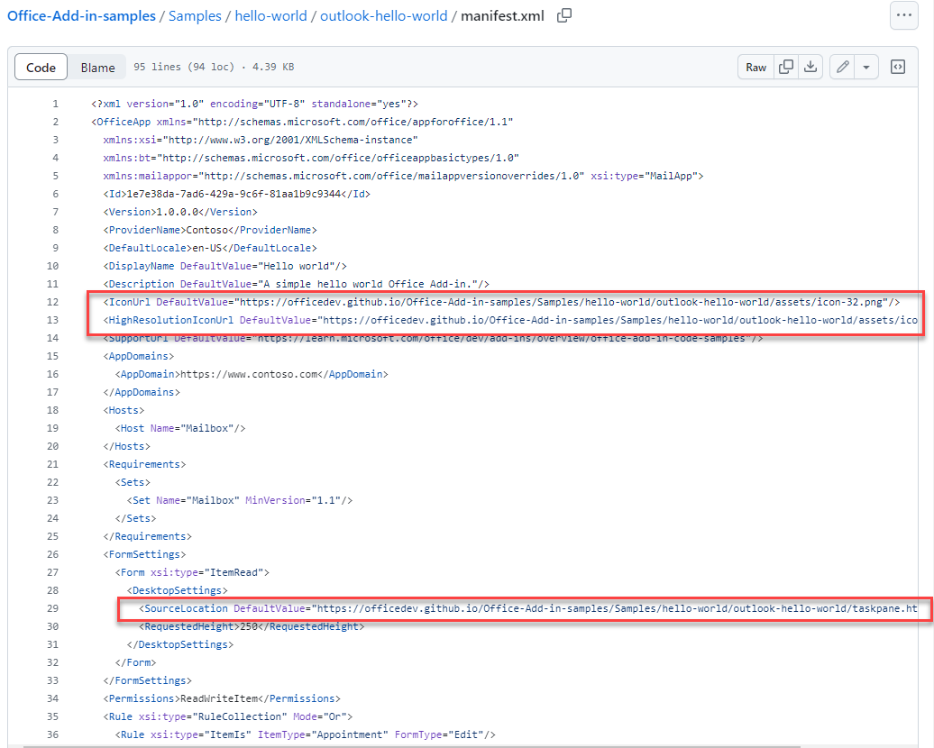

Slide 8
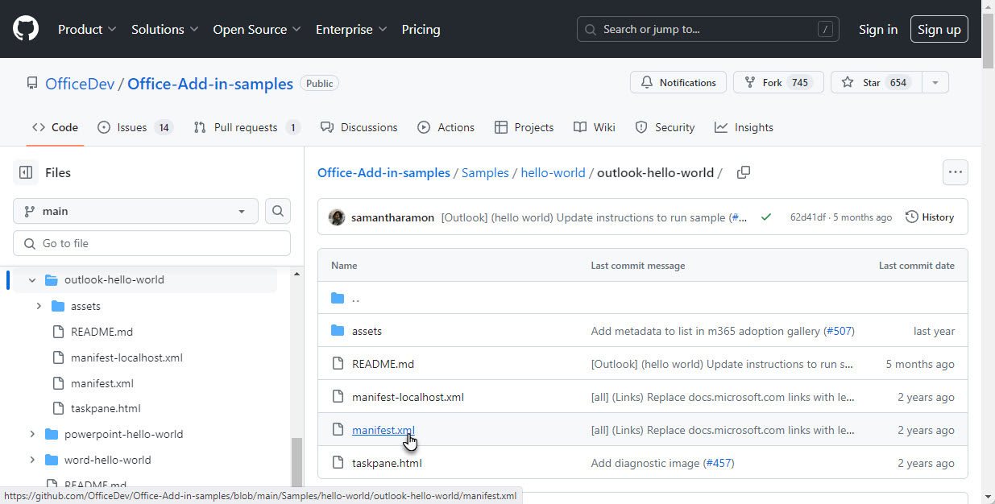

Slide 9
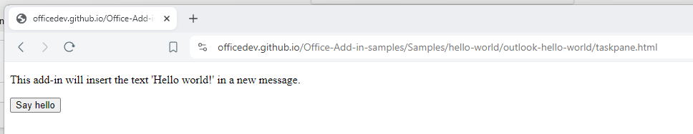
Addin HTML on Github pages

Slide 10
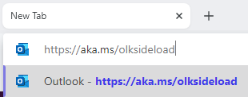
Download [from github] and upload ( to outlook add in manager] manifest file
Download Manifest File
Access https://aka.ms/olksideload
Manage Addins, Add Addin, Upload Manifest File

Slide 11
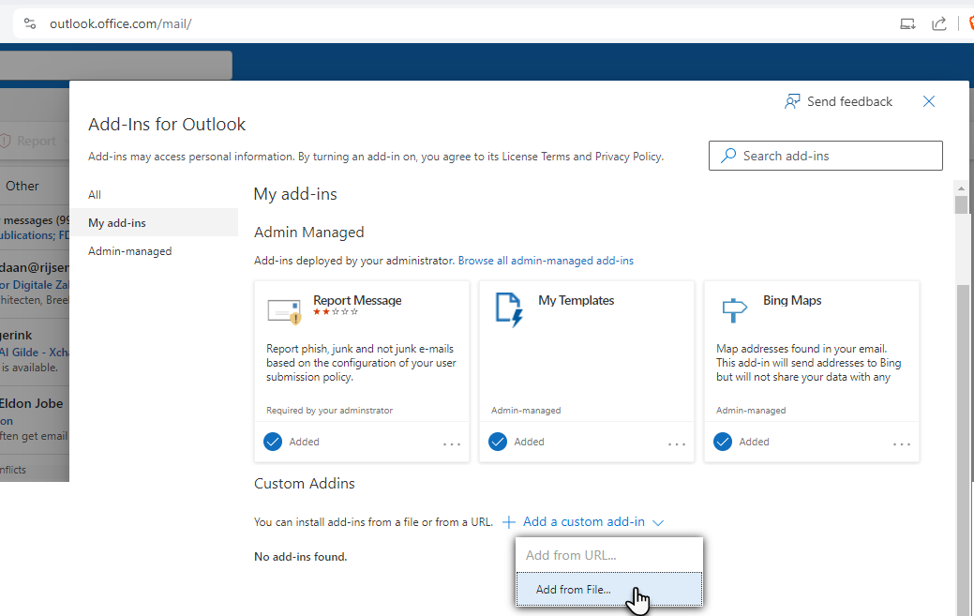
upload manifest file

Slide 12
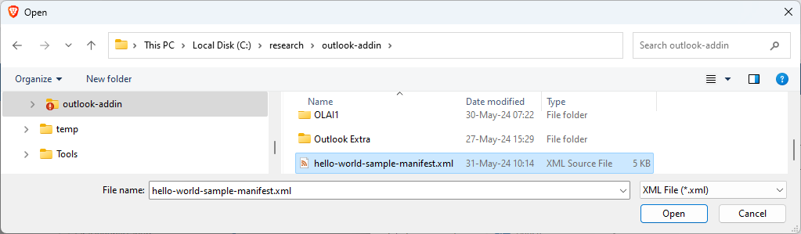
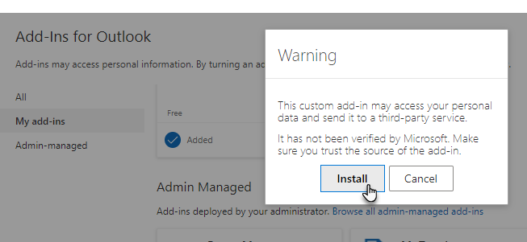
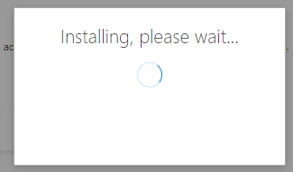
upload manifest file – Install add in

Slide 13
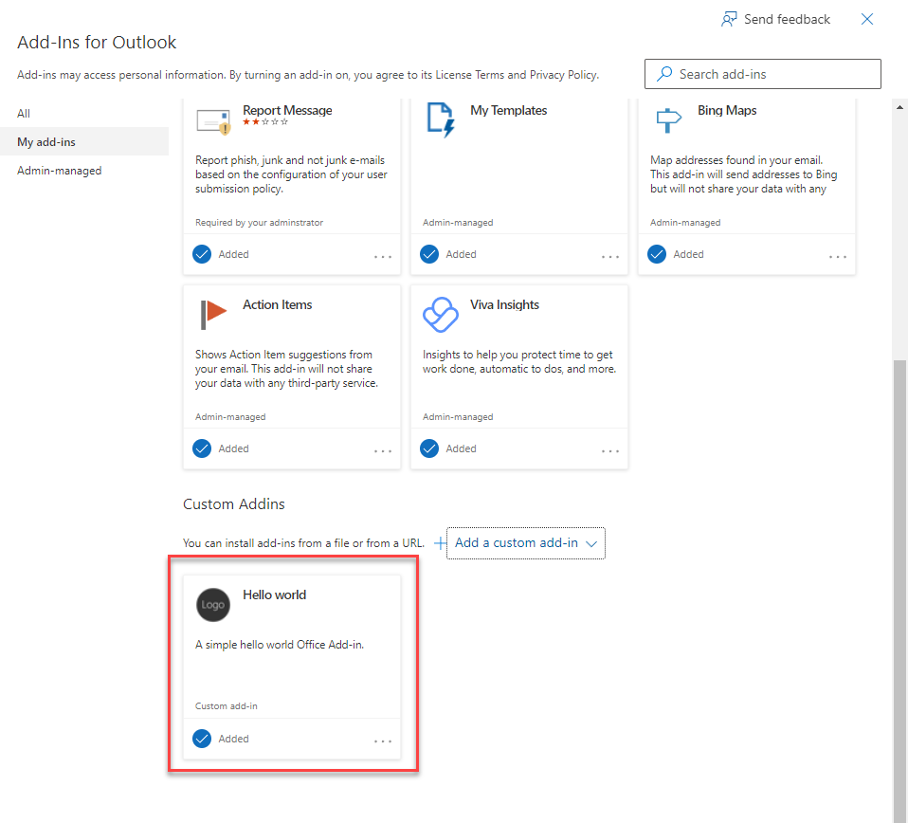
install Add in

Slide 14
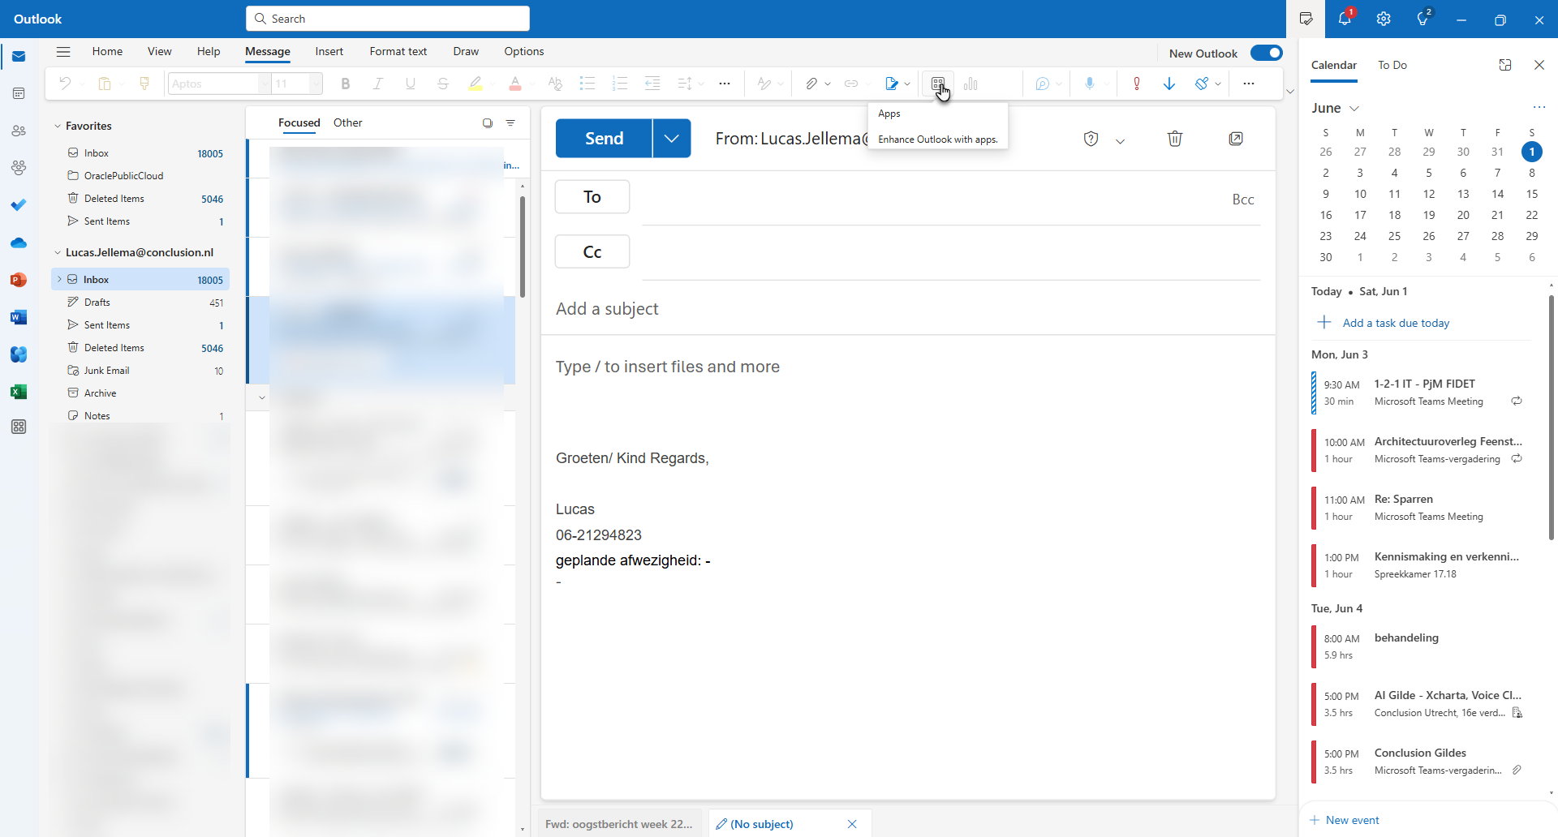
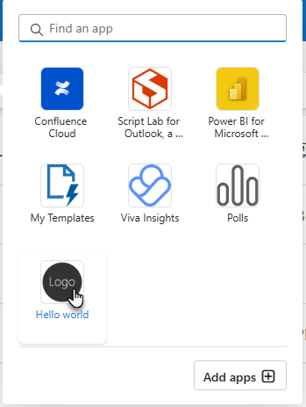

Slide 15
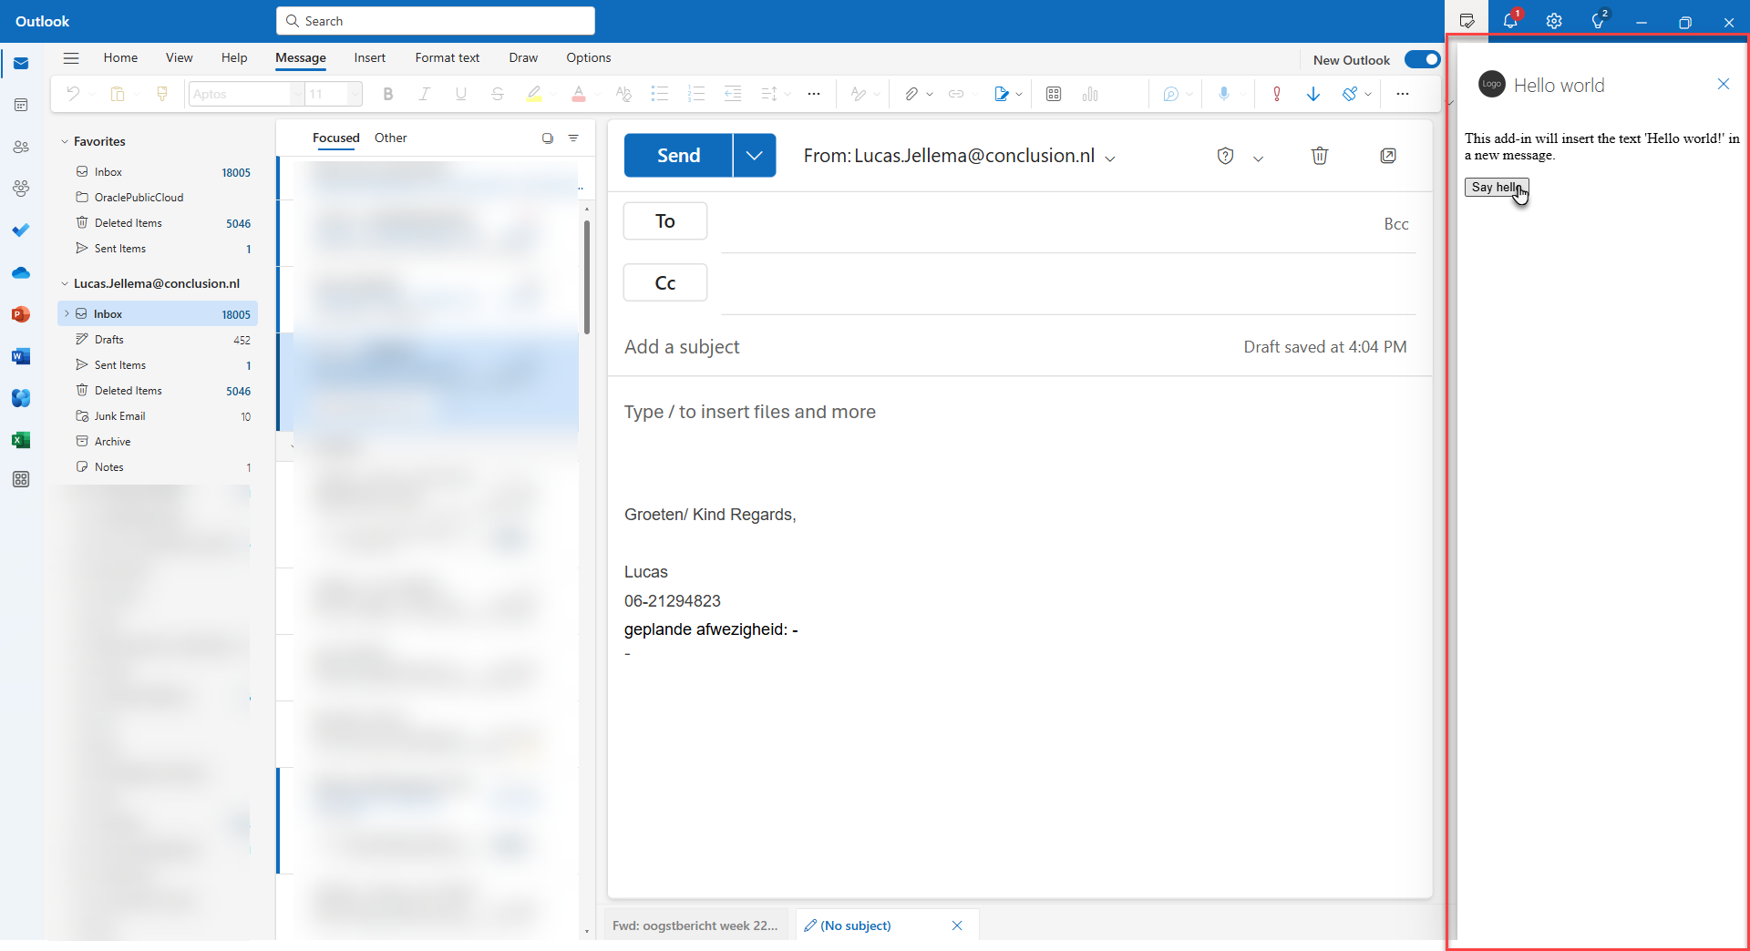

Slide 16
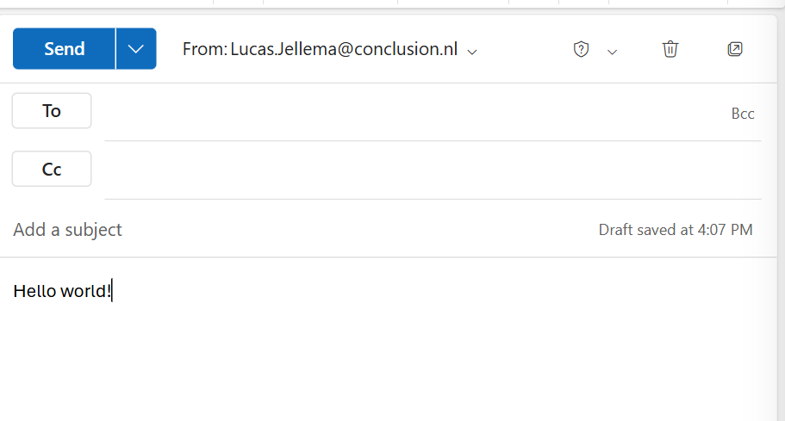

Slide 17
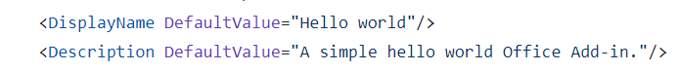
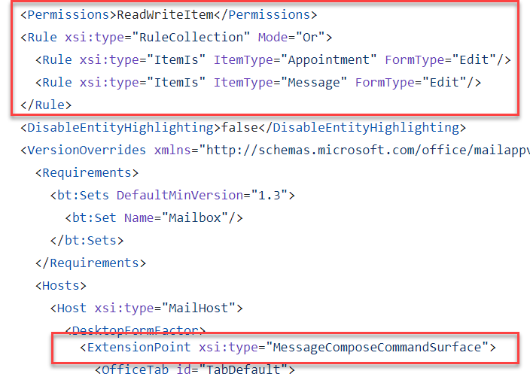

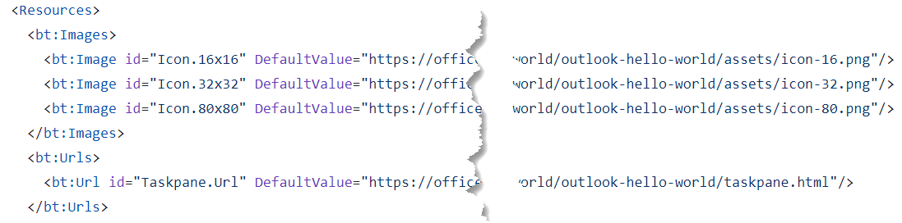
Constituents of an Addin
uploaded
manifest.xml
taskpane.html
served from GitHub Pages
uploaded

Slide 18
Constituents of an Addin
manifest.xml
taskpane.html

Slide 19
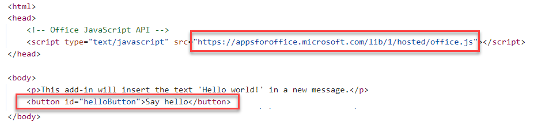
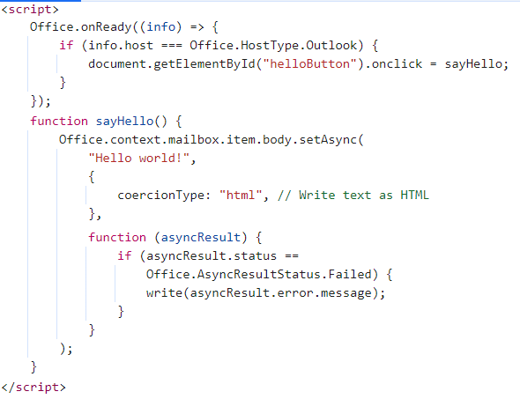
taskpane.html

Slide 20
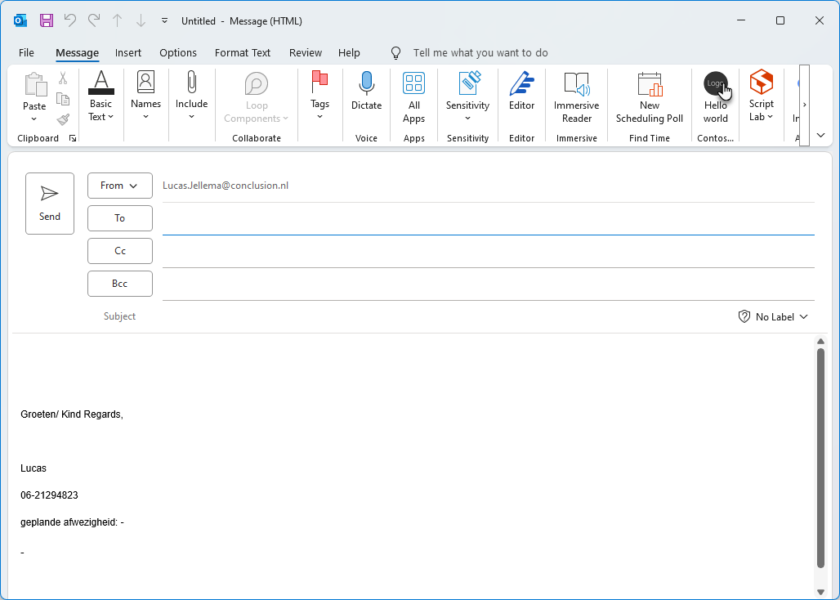

Slide 21
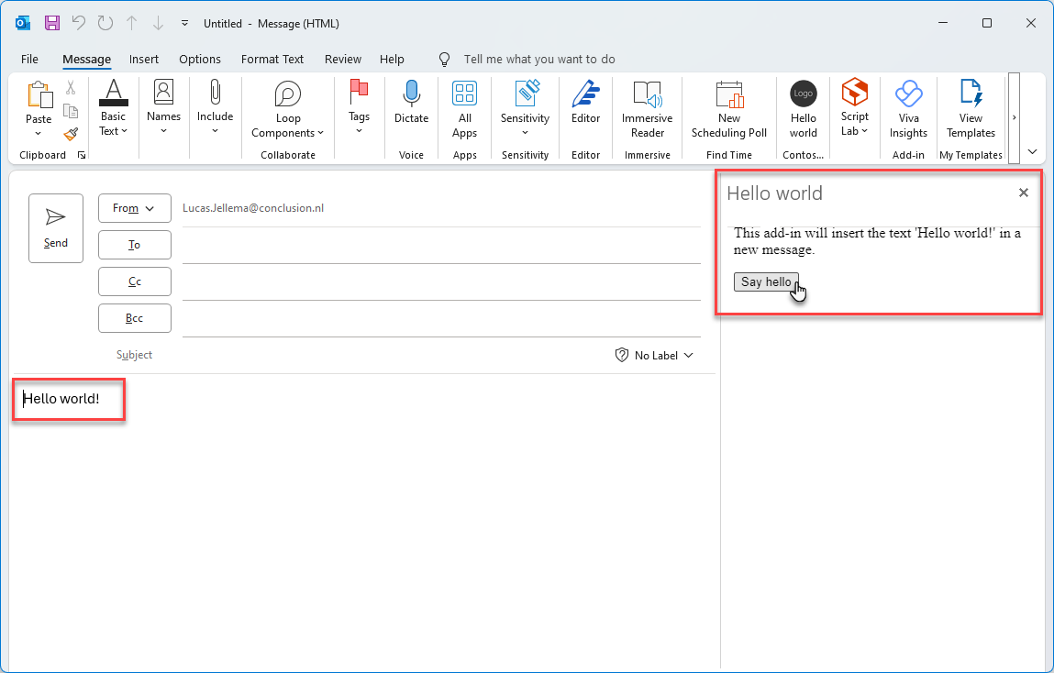

Slide 22
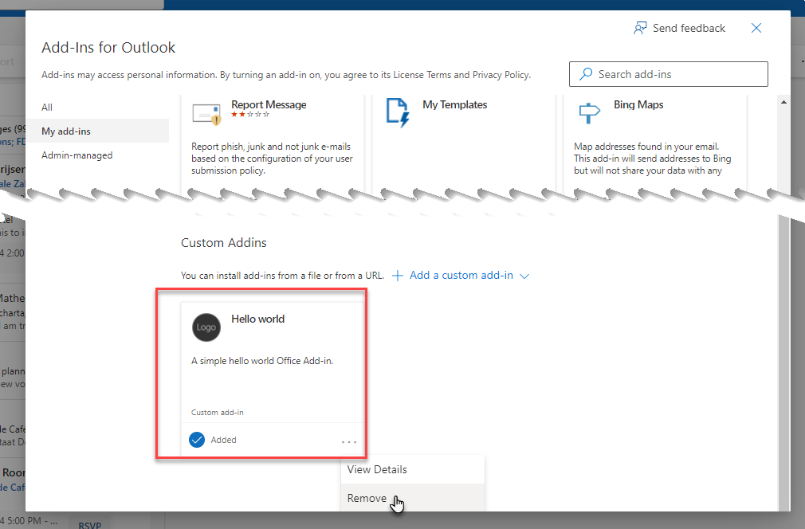
Remove Addin
Access https://aka.ms/olksideload
Manage Addins
Navigate to My Addins
Remove Addin

Slide 23
Our first custom Outlook addin: Insert image in the body of the email under construction
Addin is active when the user is editing an email => extension point
The addin has a button and when it is pressed => taskpane.html + taskpane.js
it inserts an image in the currently edited email
it could allow the user to add images (and save them in storage across sessions)
it could show multiple images (thumbnails) and allow the user to insert the image into the email by clicking on it
The addin is available in the actions menu

Slide 24
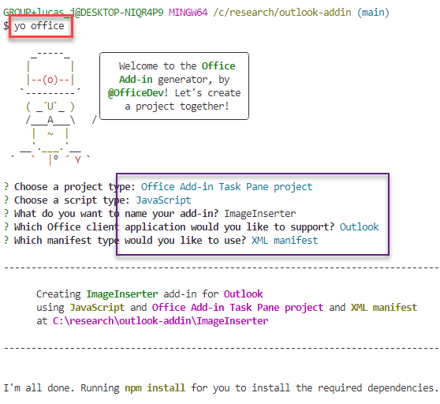
Steps for first add in
Using VS Code and Node.js
Install the latest version of Yeoman and the Yeoman generator for Office Add-ins
npm install -g yo generator-officenpm install -g yo generator-office
Create a new Office Addin using:
. yo office
and answer the questions as follows:

Slide 25
Steps for first add in
Using VS Code and Node.js
Install the latest version of Yeoman and the Yeoman generator for Office Add-ins
npm install -g yo generator-officenpm install -g yo generator-office
Create a new Office Addin using:
. yo office
and answer the questions as follows:

Slide 26
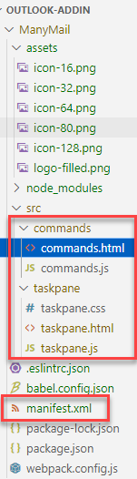
The generated Outlook ADDIN
manifest.xml
[Icons]
taskpane.html, taskpane.css and taskpane.js and/or commands.html and commands.js
the office.js API (loaded in taskpane.html and commands.html): (proper, client side) interface to M365 Office
package.json with dependencies and scripts
npm start to test run/debug addin in local Outlook Client

Slide 27
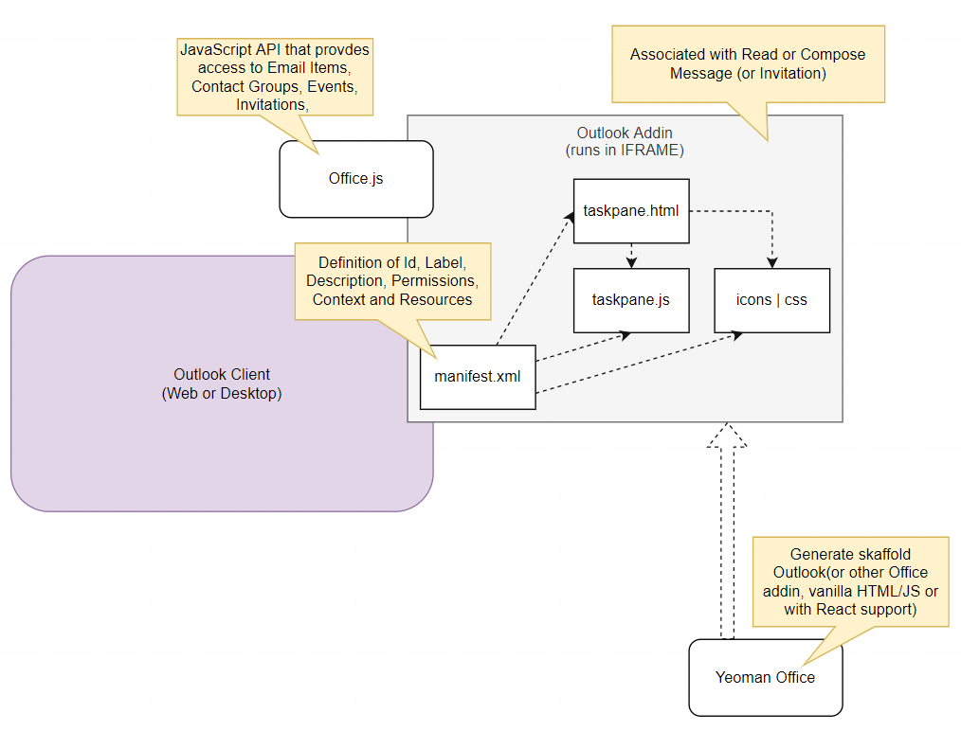
Addin core

Slide 28
Implement my functionality
Customize manifest.xml
provider name, display label, description, extension point, permissions, rules, labels, icons
Edit taskpane.html
implement the desired UI
Edit taskpane.js
implement the desired behavior
Test Run Addin (locally)
Publish Addin (on GitHub Pages)

Slide 29
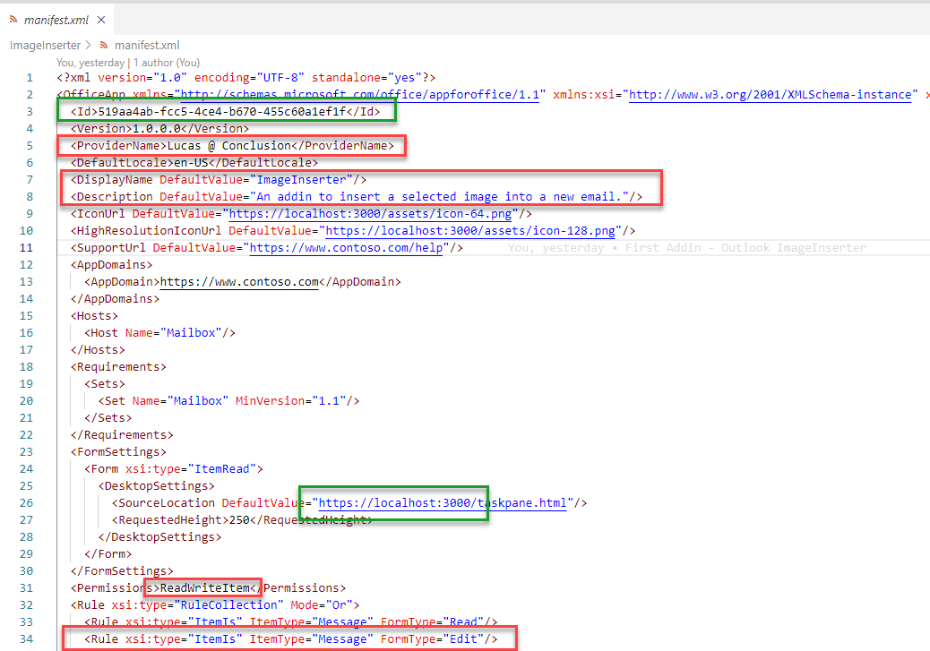

Slide 30
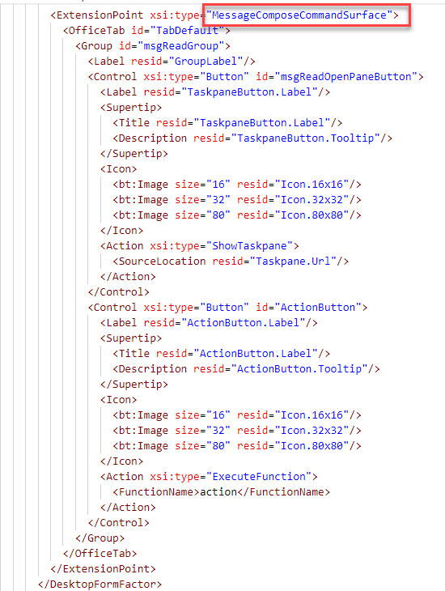
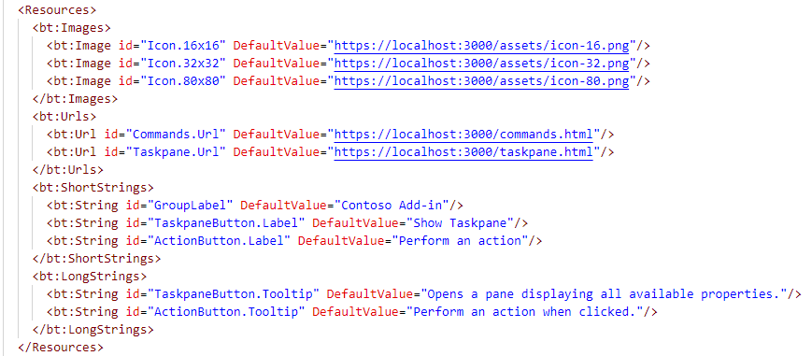

Slide 31
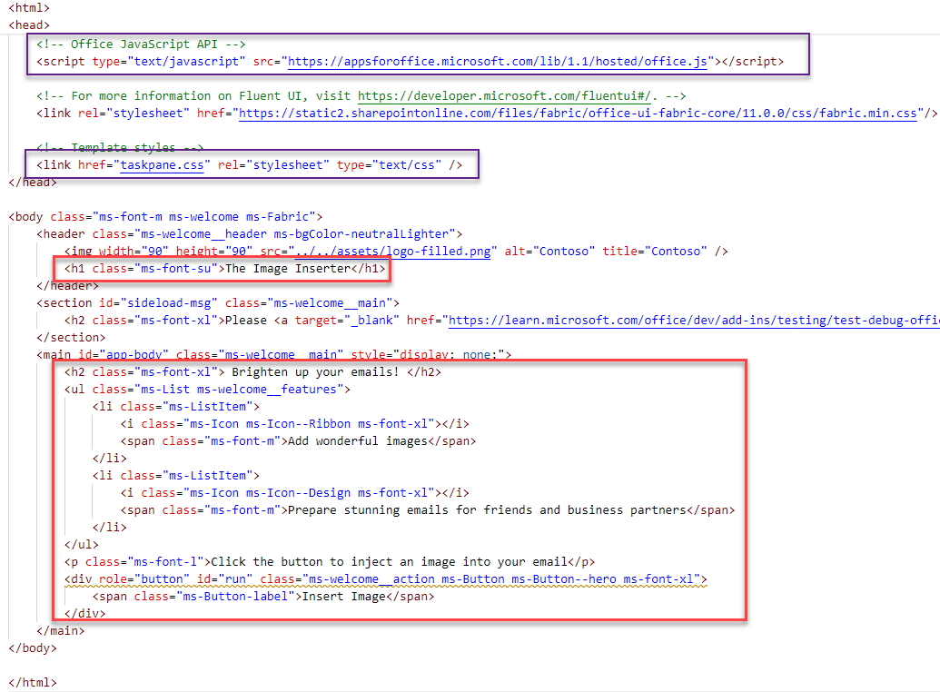
Taskpane.html

Slide 32
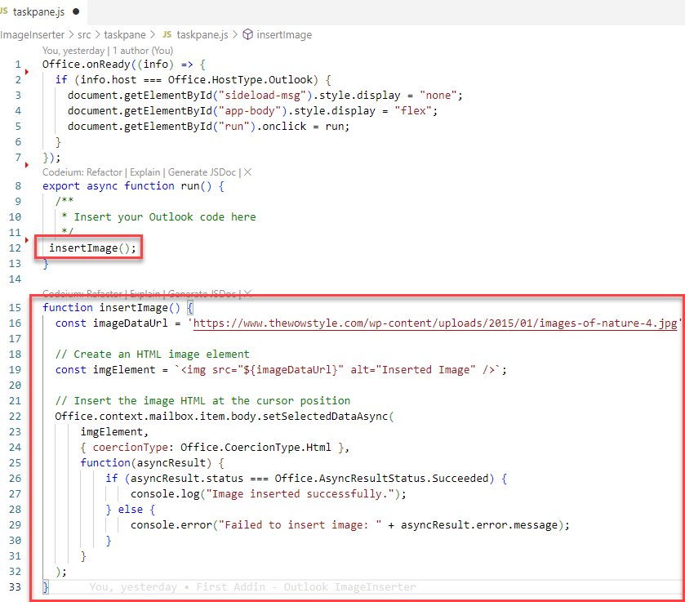
Taskpane.js

Slide 33
Implement my functionality
Customize manifest.xml
provider name, display label, description, extension point, permissions, rules, labels, icons
Edit taskpane.html
implement the desired UI
Edit taskpane.js
implement the desired behavior
Test Run Addin (locally)
npm start: run Addin in local Outlook client
Publish Addin (on GitHub Pages)

Slide 34
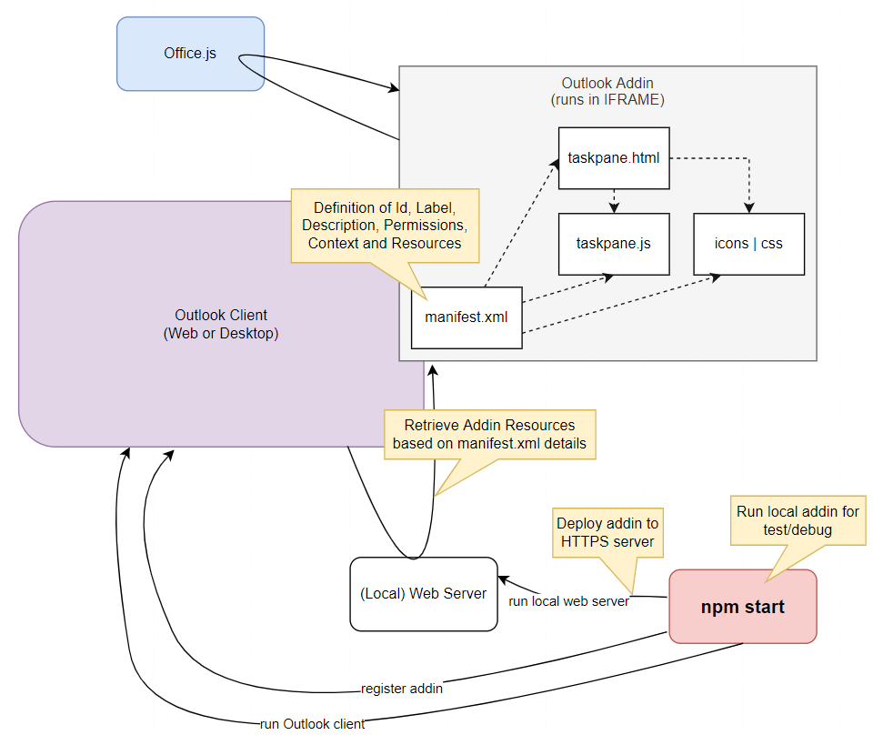
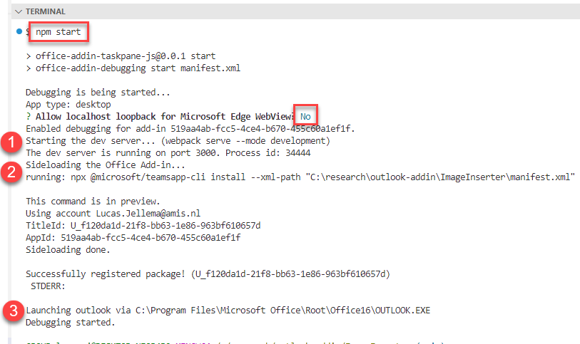
Test Run Addin locally

Slide 35
Test Run Addin locally

Slide 36
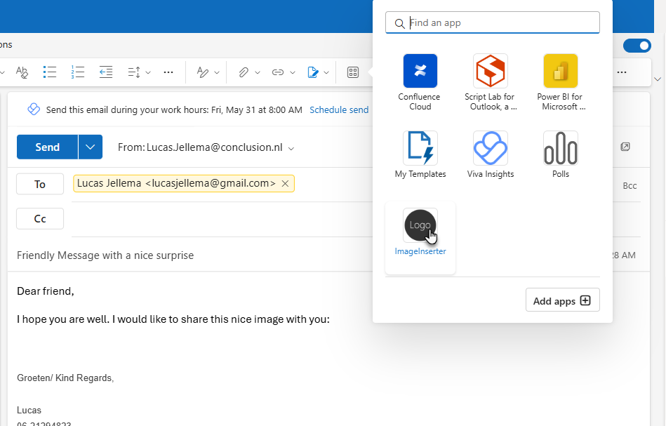
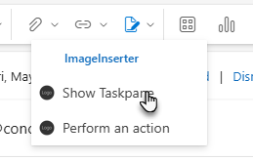
Test Addin on new mail message

Slide 37
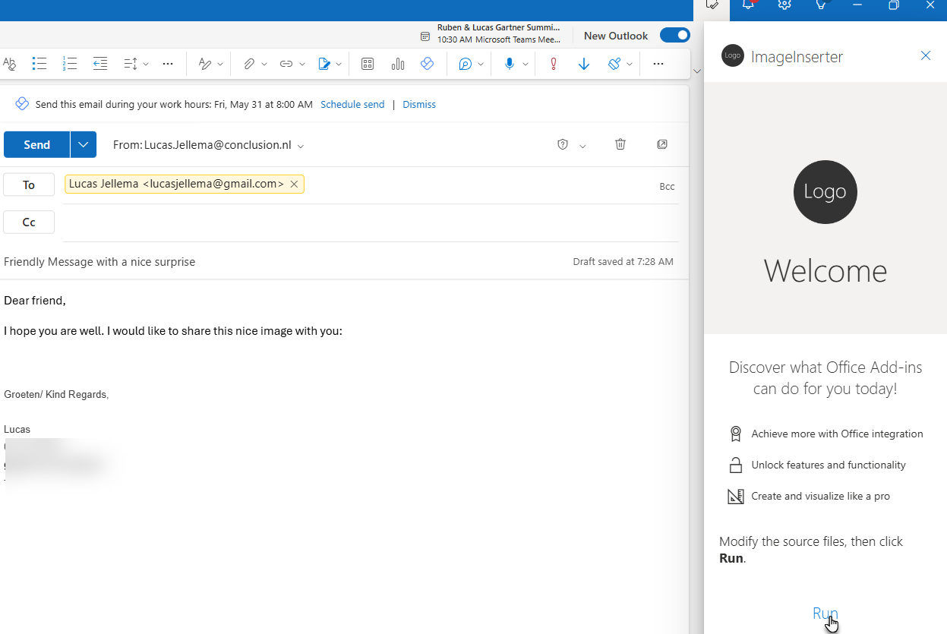
Test Addin on new mail message

Slide 38
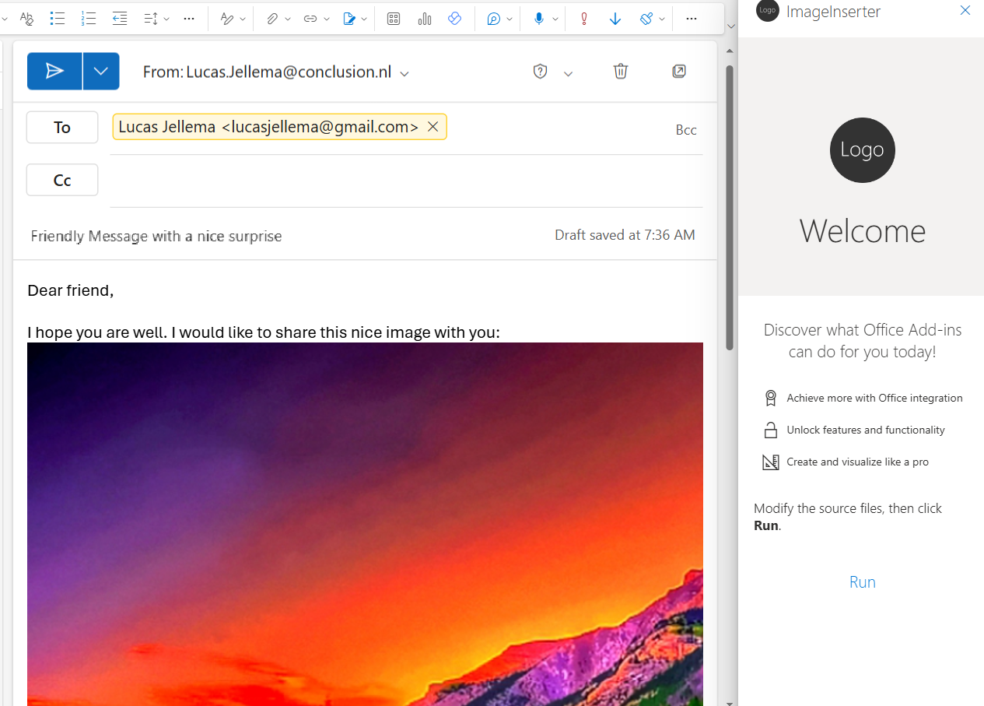
Test Addin on new mail message
Note: any change in the taskpane.html or taskpane.js is immediately reflected in the Outlook client

Slide 39
Implement my functionality
Customize manifest.xml
provider name, display label, description, extension point, permissions, rules, labels, icons
Edit taskpane.html
implement the desired UI
Edit taskpane.js
implement the desired behavior
Test Run Addin (locally)
npm start: run Addin in local Outlook client
Publish Addin (on GitHub Pages)
Commit & Push Addin artifacts to a GitHub Repository
Enable GitHub Pages on the Repository
Update the (local) manifest file: all localhost references should be replaced with GitHub Pages references

Slide 40
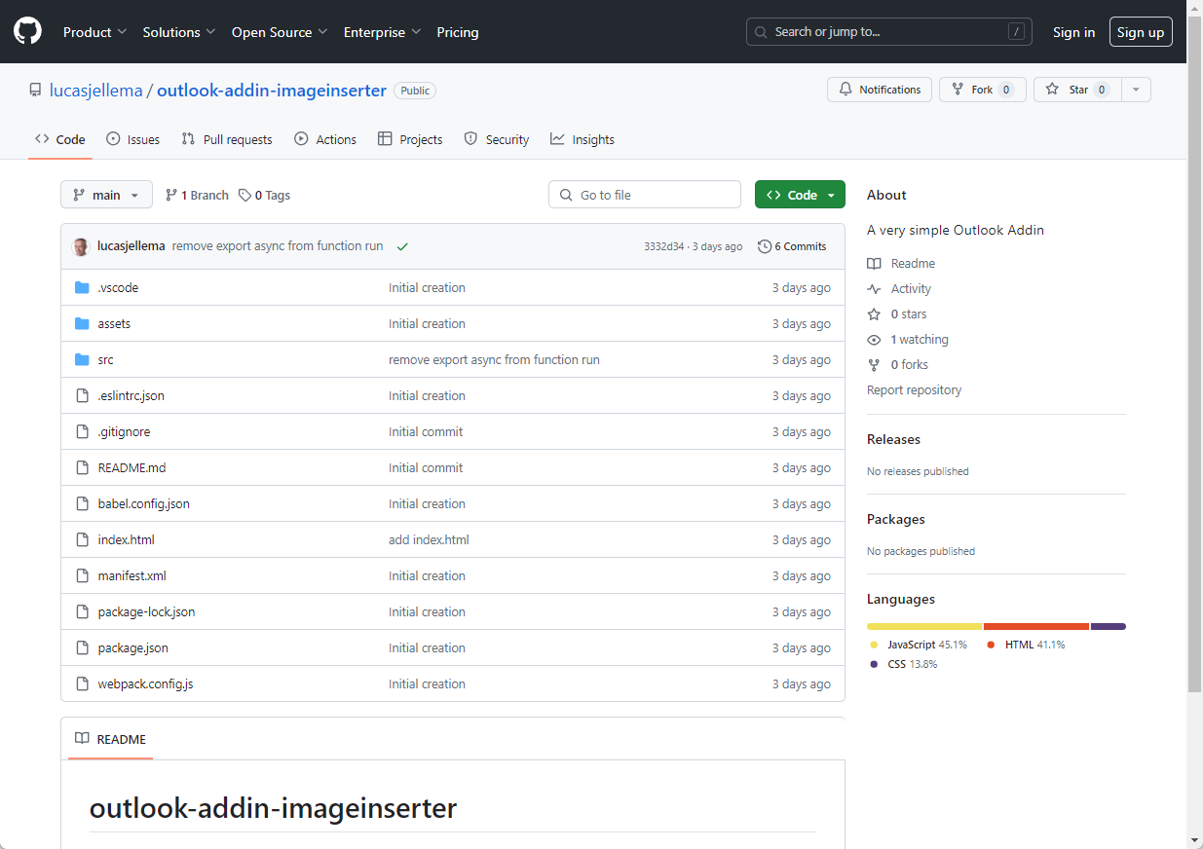
GitHub Repository

Slide 41
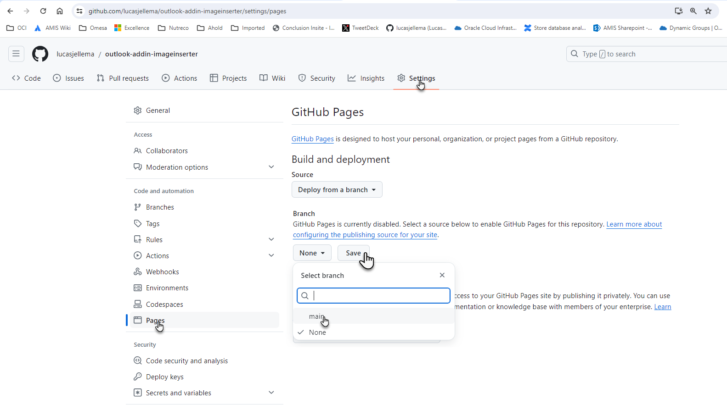
Deploy to github Pages

Slide 42
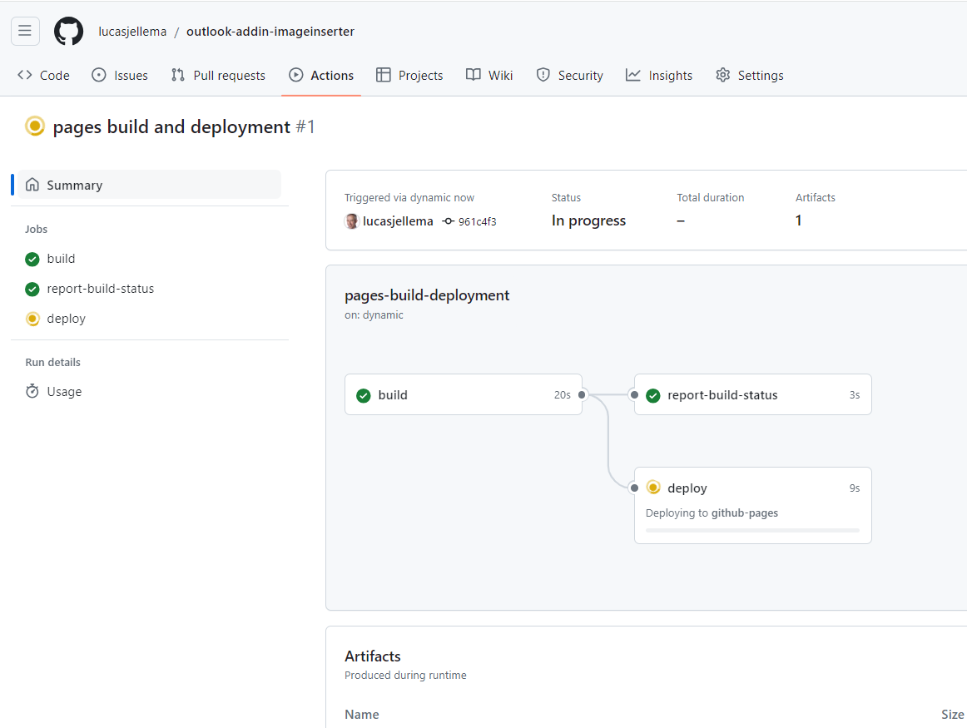
GitHub Actions kick off workflow

Slide 43
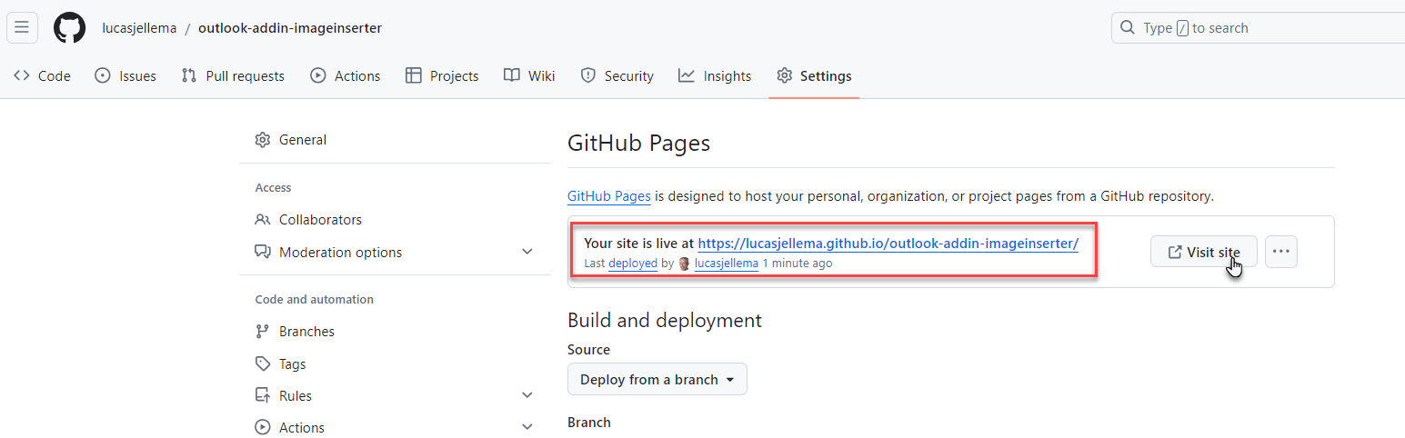
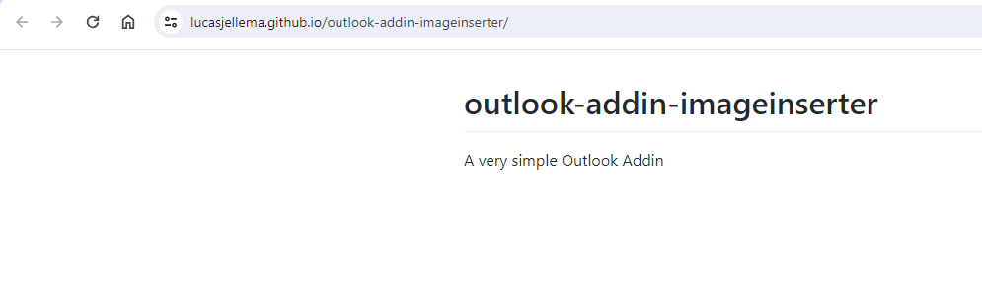
And report back the url for the web app

Slide 44
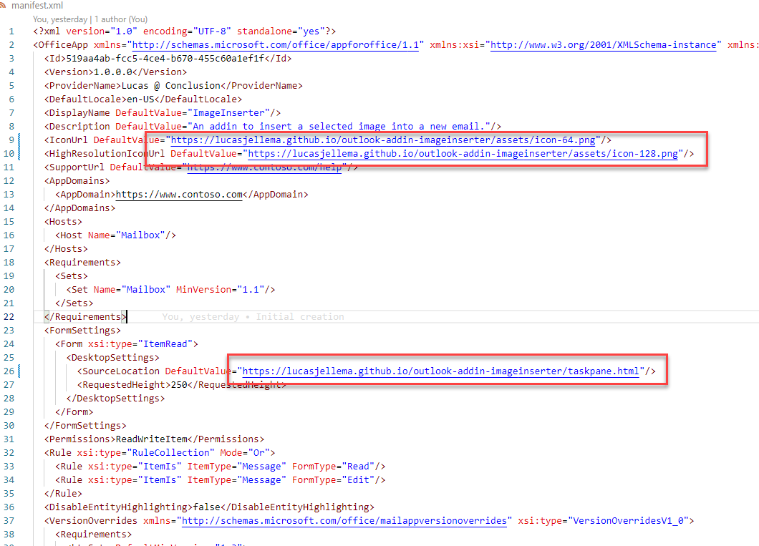
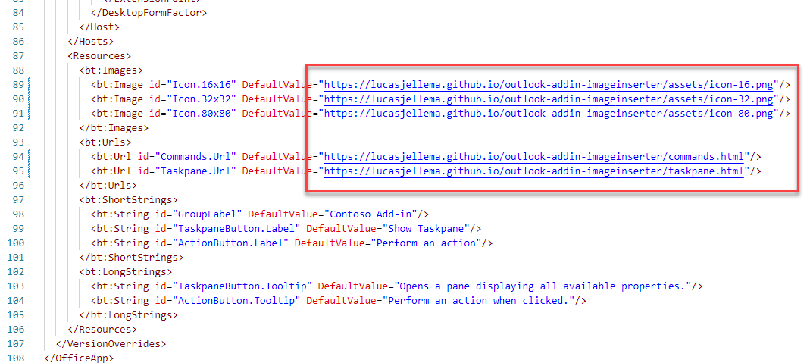
Update (local) manifest to refer to addin assets on GitHub Pages

Slide 45
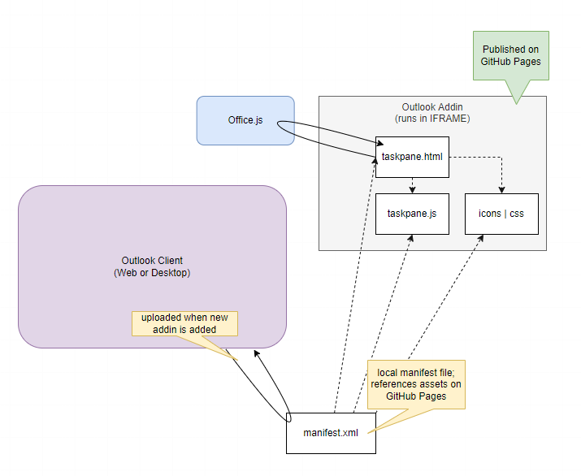
Add Addin to any Outlook client anywhere
With the Addin assets in a public static website on GitHub Pages
And a manifest.xml file that references those assets
The Addin can be added to any Outlook Client anywhere
just as with the Hello World Addin

Slide 46
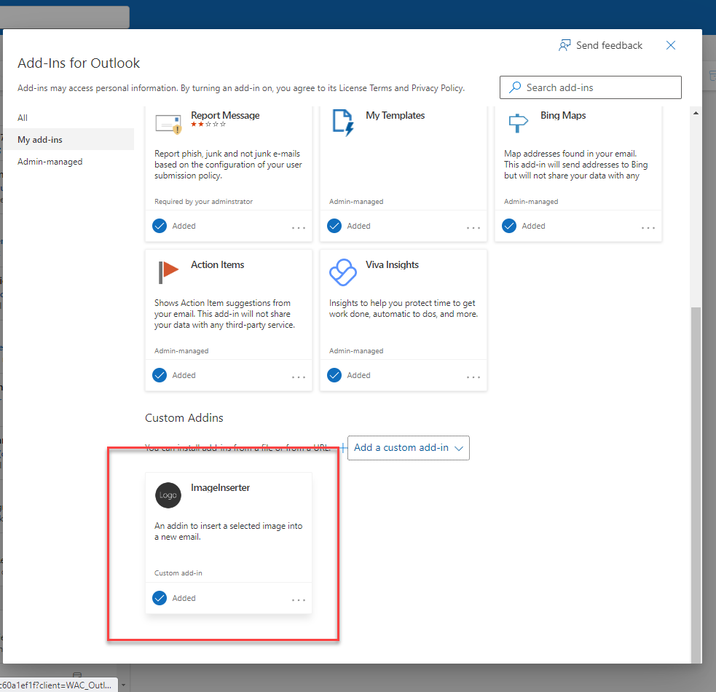
Add Addin to any Outlook client anywhere
With the Addin assets in a public static website on GitHub Pages
And a manifest.xml file that references those assets
The Addin can be added to any Outlook Client anywhere
just as with the Hello World Addin
Open website https://aka.ms/olksideload
Upload manifest.xml file
Create a new mail and benefit from addin to add a beautiful image

Slide 47
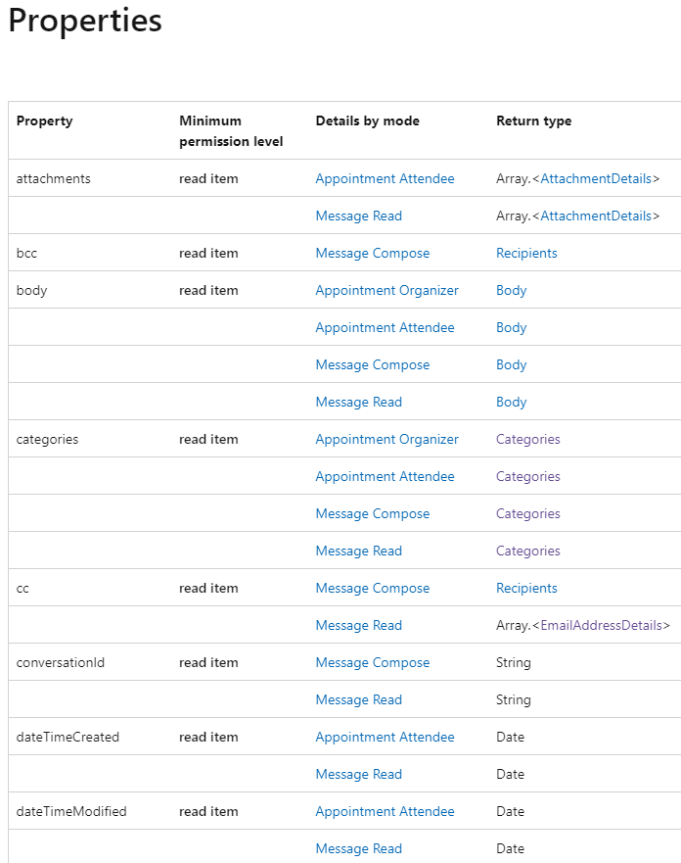
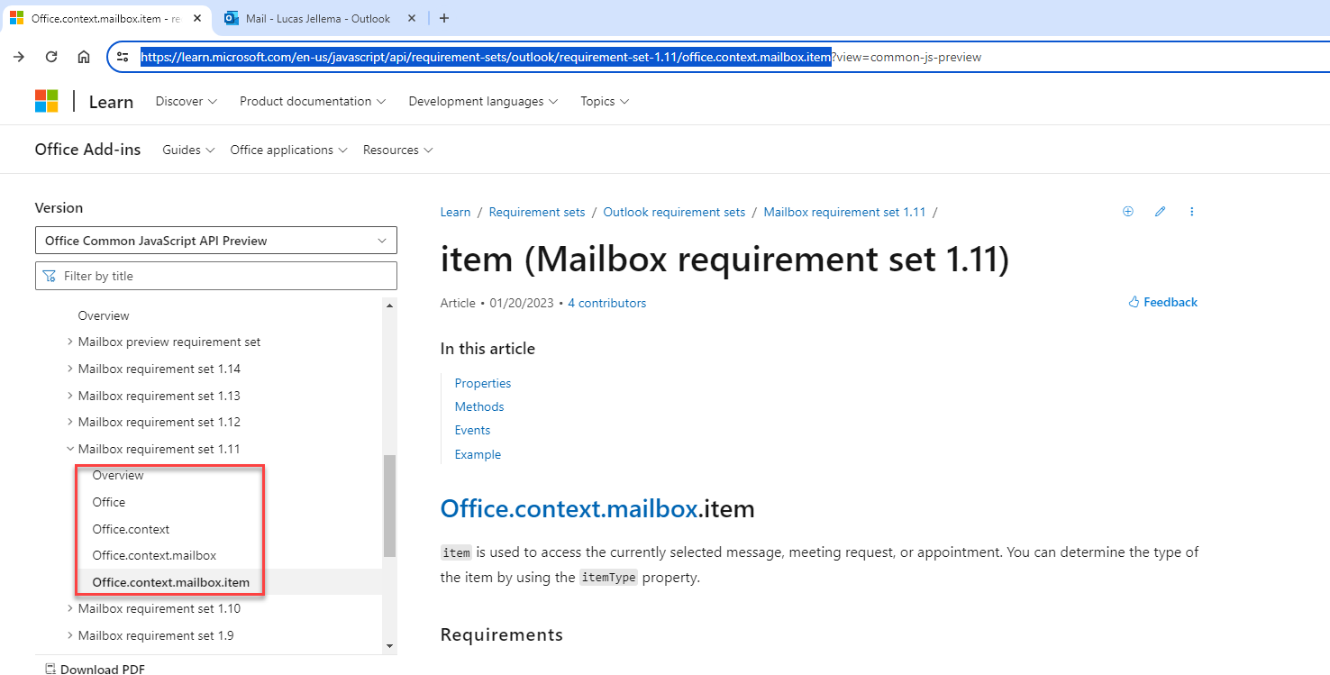
Addin #2 – Retrieve Message details
Leverage the Office API for inspecting a Mail Item
Office.context.mailbox.item
Notes:
https://learn.microsoft.com/en-us/javascript/api/requirement-sets/outlook/requirement-set-1.11/office.context.mailbox.item

Slide 48
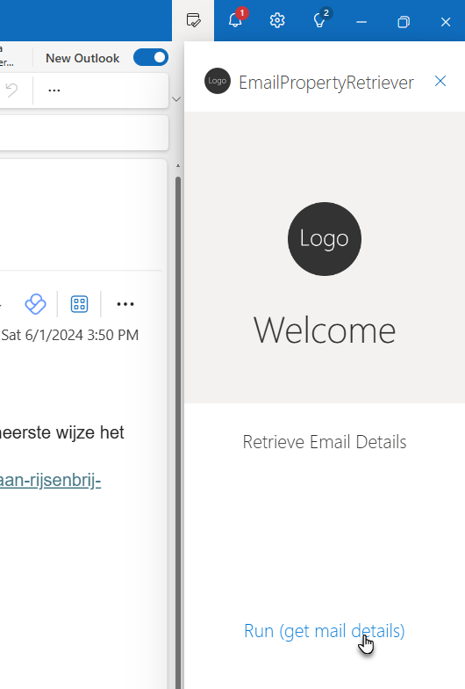
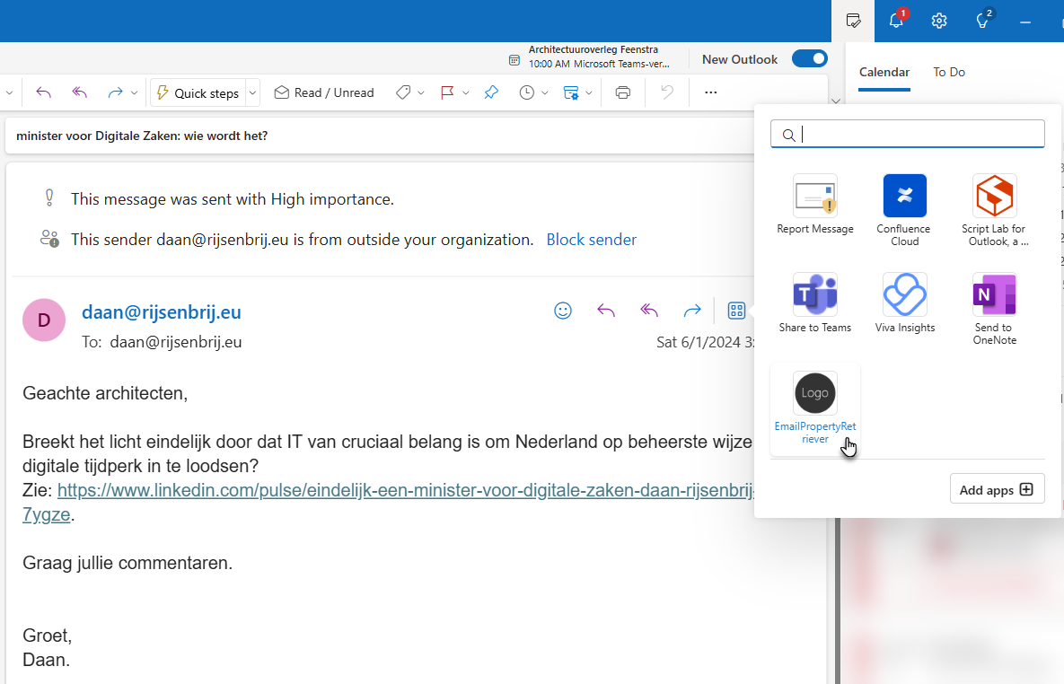

Slide 49
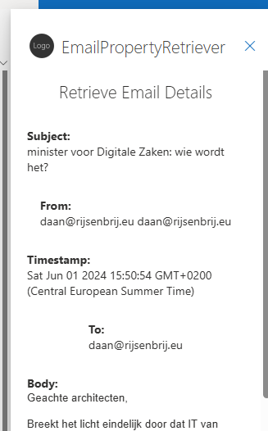


Slide 50

Another custom Outlook addin: gather email details in Sidepane
Addin is active when the user is reading an email => extension point
The addin has a button and when it is pressed => taskpane.html + taskpane.js
it collects timestamp, sender, subject from email
and writes the details in the side pane
it could send the email details to a backend service
it could create a summary of the body, collect images and attachments and send details to an API, local storage or a document on OneDrive
The addin is available in the actions menu

Slide 51

manifest.xml

Slide 52

manifest.xml

Slide 53

taskpane.html

Slide 54

taskpane.js

Slide 55

Addin to process appointment details

Slide 56

Addin to process appointment details

Slide 57

Addin to process appointment details

Slide 58
Addin to process appointment details
Shows when an appointment is open for the organizer – in read mode
in compose mode – the details of the attendees do not seem to be available
The addin only works in the “old” Windows Look and Feel – not the new and not in Web Client
I do not know why that is! (took me a lot of time to figure that out)

Slide 59

Manifest.xml – for Appointment addin

Slide 60

taskpane.js

Slide 61


taskpane.js

Slide 62

taskpane.js

Slide 63

RSVP Handler addin
Interprets data in a reaction to an appointment invitation
Stores data in local storage
maintain list of all reactions to a meeting’s invitation
Can display all reactions and copy them to clipboard
example of using local storage

Slide 64

RSVP Handler addin

Slide 65

special elements retrieve appointment response details
itemClass: ….Pos, ….Ten, ….Neg

Slide 66


special elements Store data in and retrieve from local storage
local storage

Slide 67
My original objective – the holy grail of outlook addin functionality
Send emails and invitations
To multiple recipients
Personalized
Based on easily managed contact lists
(fully) Automated

Slide 68



What an Addin can and cannot do
Paste multiple recipients in to and cc and bcc properties of an email
Paste rich content to body of email
Create a new email message window for every recipient in a list
including personalized content
Addin cannot send the email
workaround: Microsoft Graph API and EWS (Exchange Web Services) (require permissions from Office Administrator and App Registration of Addin)

Slide 69


Slide 70

Workaround: Outlook Addin ⬄ Browser Extension bridge
When using the Outlook Web Client running in Chrome Browser
We can introduce a Browser Extension into the mix
Browser extension can do things in the main document that the Addin (in an IFRAME) cannot do
click buttons that a user can click - such as the Send button

Slide 71

Outlook Addin ⬄ Browser Extension bridge
top document
IFRAME
Outlook Addin
inform script about what it should do
inject script
compose.js

Slide 72

Approach
Outlook Addin
Creates New Message (Window)
Sets To, Subject, Body
Chrome Browser Extension
Injected into document
Finds and clicks the Send button (but only when …)

Slide 73



Outlook Addin

Slide 74


Trick to signal from Addin to Chrome browser extension..
Extension is loaded into all documents with as ultimate origin "https://outlook.office.com/*"
including the new message window (that itself has about:blank as location)
It locates the Bcc element and checks for the value autosend@contoso.com
if that value is found, then the Send button is located and clicked – the mail is sent and the window closes

Slide 75

SEND button and bcc field in html

Slide 76

What does this provide?
Create an email – send to self
Open that email in read mode
Open Addin
Paste CSV with recipient data
Process / Refine Data
Press button to Send All mail

Slide 77

What does this provide?
Create an email – send to self
Open that email in read mode
Open Addin
Paste CSV with recipient data
Process / Refine Data
Press button to Send All mail

Slide 78

What does this provide?
Create an email – send to self
Open that email in read mode
Open Addin
Paste CSV with recipient data
Process / Refine Data
Press button to Send All mail

Slide 79
What does this provide?
Addin creates personalized emails for all recipients
each one in its own window
Extension kicks in (triggered by bcc) to click on the Send button

Slide 80

Example of one of the personalized emails

Slide 81
Alternative approach to be investigated
Many Mail addin
Outlook Addin is instructed to create personalized mails
addin stores data on the new mail(s) in local storage
addin posts message to have a new mail created
Create New Email inside Outlook Window
through Chrome Extension, triggered by message from Add In’s IFRAME
Outlook addin is removed once the new mail replaces the current mail message
Add content details to New Email from Outlook Add In that is triggered by new mail event
it reads from local storage what mail it should compose next and removes the data for that one mail
it posts message to have the mail sent and a new one created (if that is required)
Send Email
through Chrome Extension, triggered by message from Add In’s IFRAME
and create a new one if so instructed
Outlook Web Client Message
local storage
On New Message addin
On New Message addin
On New Message addin
Chrome extension

Slide 82

Outlook Addin ⬄ Browser Extension bridge – the moving parts
Extension has content script to
Inject JavaScript into Outlook Web Client to send messages to (Add In’s IFRAME)
listen for messages from IFRAME
find & click a button to create a New Mail or Send a Mail
I pressed the button
please press send mail button
local storage
contains queue of all mails to be created and sent; in each iteration, takpane.js reads and removes one record, composes the email and has it sent
find and click send mail button

Slide 83
How to send appointment (event invitation) to many recipients (personalized?)
Create appointment
Forward to oneself – now it is a mail message
Add placeholders to the body
Send personalized to many recipients
do they receive it as an invite that is included in their calendar?

Slide 84
Addin to send personalized emails to multiple recipients
Requirement:
take a CSV with people, each with an email address, first name, company name and other properties
send the current email or invitation (that contains placeholders such as {{email}}, {{firstName}}) to each of the people in the CSV and personalize the message before sending it
Challenge: Addin cannot send an email (only through server side calls to EWS or Graph API, not by leveraging the client); Addin can open a new message form but it cannot interact with it; and it cannot interact with the elements in the parent document (such as the New Mail and Send buttons)
Workaround: use Chrome Extension to listen for requests from addin and press the requested buttons
addin reads current email and processes CSV; for each person, it create a new mail (through the extension), personalizes the content and sends the mail (again, through the extension)
note: this only works in the Outlook Web Client

Slide 85
get details on event responses:
// Link to full sample: https://raw.githubusercontent.com/OfficeDev/office-js-snippets/prod/samples/outlook/30-recipients-and-attendees/get-optional-attendees-appointment-attendee.yaml
const apptOptionalAttendees = Office.context.mailbox.item.optionalAttendees;
console.log("Optional attendees:");
for (let i = 0; i < apptOptionalAttendees.length; i++) {
console.log(
apptOptionalAttendees[i].displayName +
" (" +
apptOptionalAttendees[i].emailAddress +
") - response: " +
apptOptionalAttendees[i].appointmentResponse
);
}

Slide 86





Addin to execute function on New Message event
https://learn.microsoft.com/en-us/office/dev/add-ins/outlook/autolaunch
Notes:
https://learn.microsoft.com/en-us/office/dev/add-ins/outlook/on-new-compose-events-walkthrough?tabs=jsonmanifest

Slide 87

Office JS Snippets for Outlook: https://github.com/OfficeDev/office-js-snippets/tree/main/samples/outlook
Save addin settings
https://learn.microsoft.com/en-us/office/dev/add-ins/outlook/one-outlook#debug-your-add-in
olk.exe --devtools

Slide 88
Basics of an Outlook ADDIN
manifest.xml
[Icons]
taskpane.html, taskpane.css and taskpane.js and/or commands.html and commands.js
the office.js API (loaded in taskpane.html and commands.html): (proper, client side) interface to M365 Office
addin must be served over HTTPS (locally or centrally, for example GitHub Pages)
or be published on AppSource (publicly) or Microsoft 365 admin center (within organization)
addin can have state – settings/options or business data, stored locally or roaming(ly)

Slide 89
Logo
www.conclusion.nl

